Slide 1
Delta Loading with Non SAP
Milind Parab

Slide 2
Pre-Requisites for the Demo.
Load Master Data.
Create Flat File Transaction Data.
Create Info Objects.
SMID : SIDxx
PID: PIDxx
Quantity: QTY_xx
Sales: SREV_xx
Profit: PR_xx

Slide 3
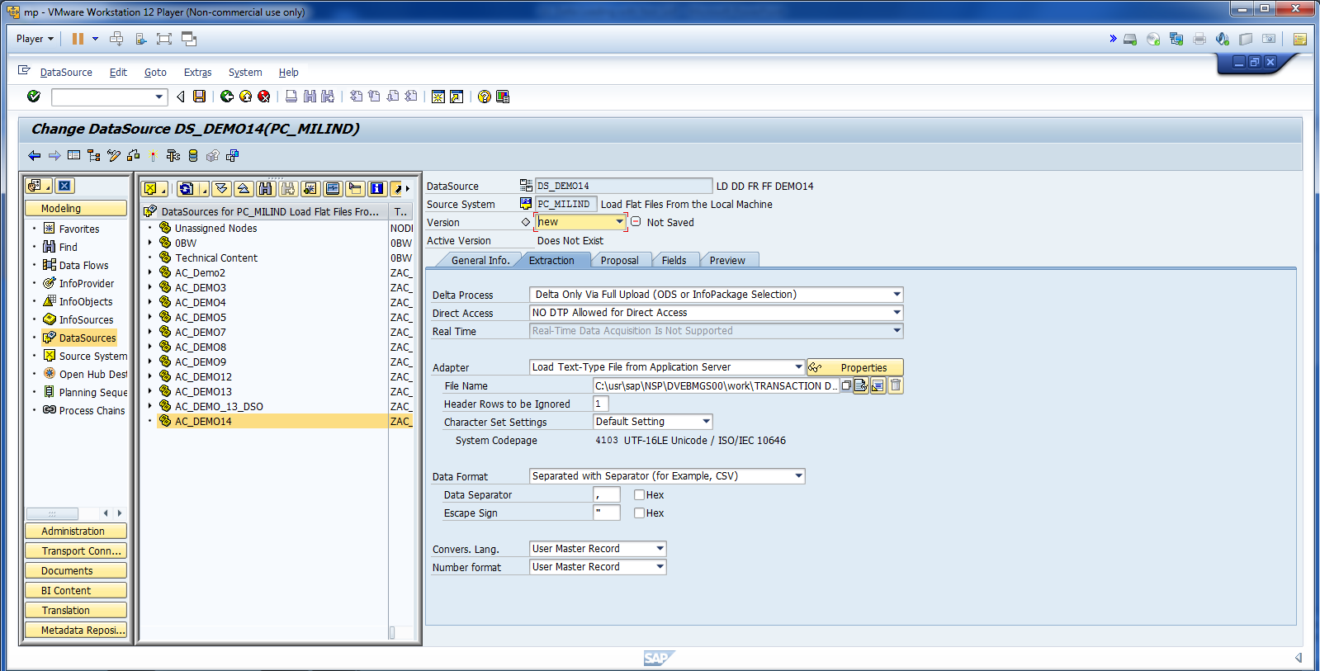
Update Adapter and update the path.

Slide 4
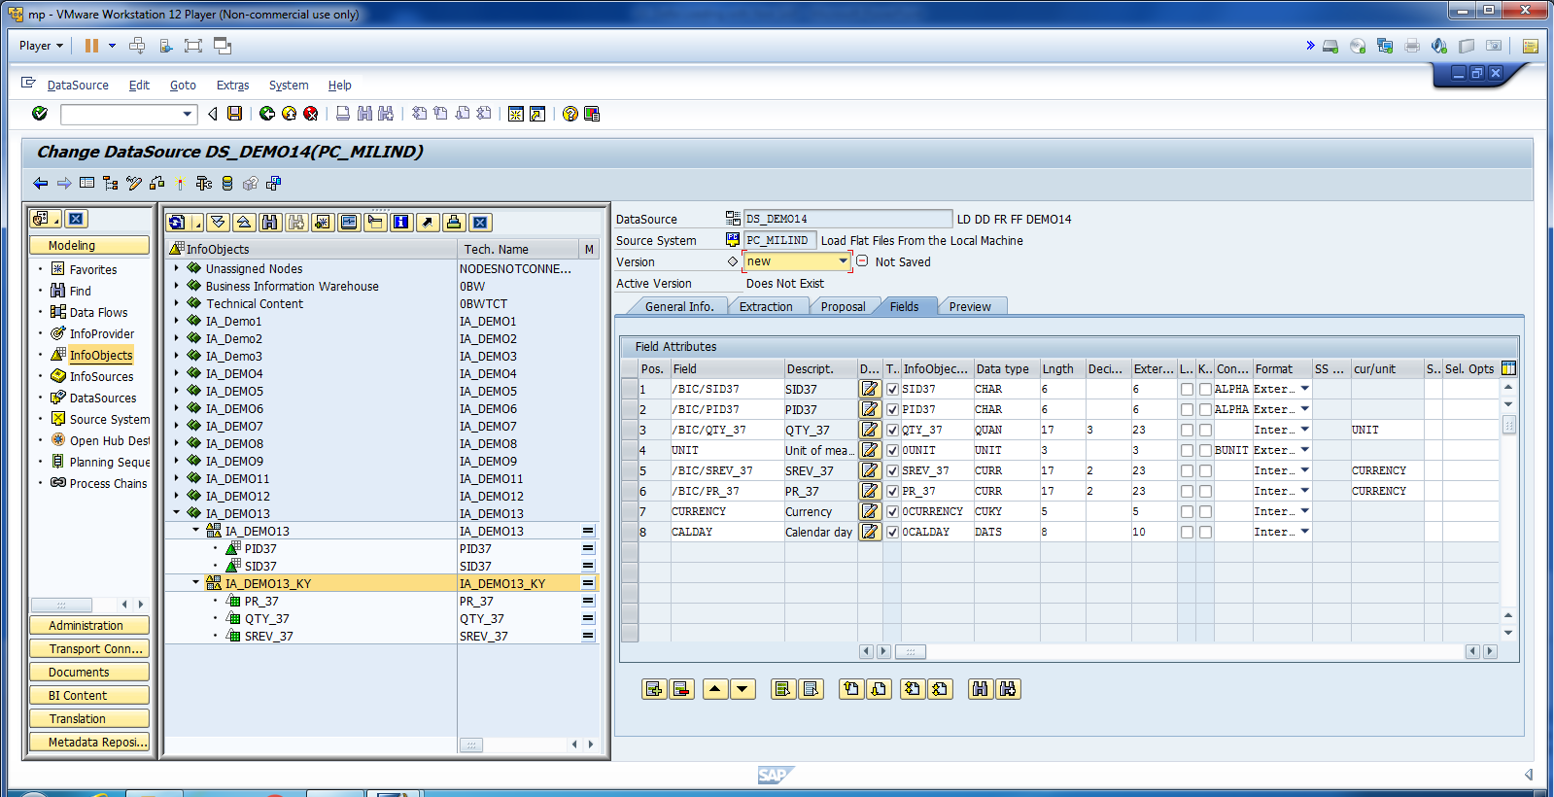
Map all fields.

Slide 5
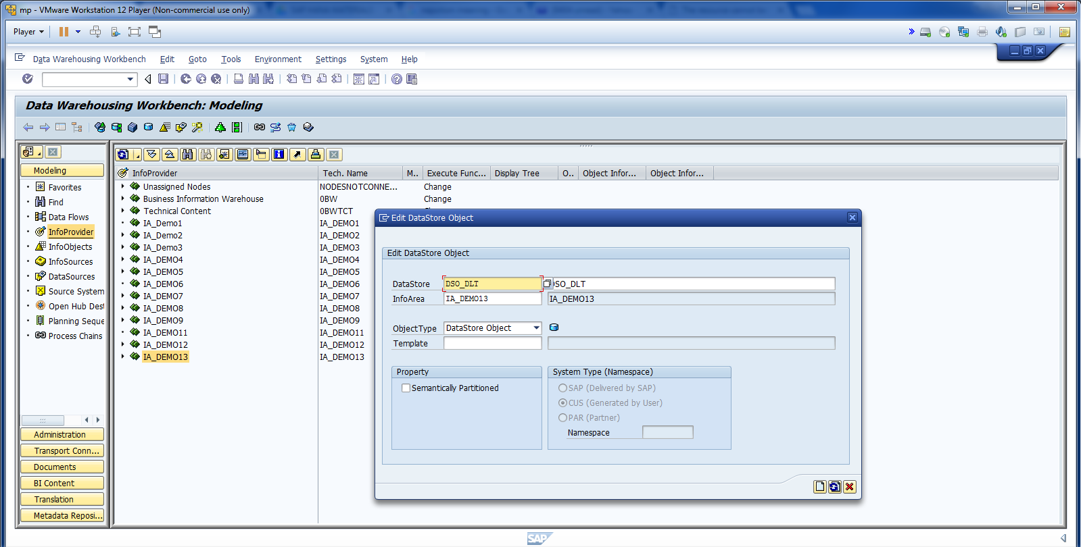
Create DSO.

Slide 6
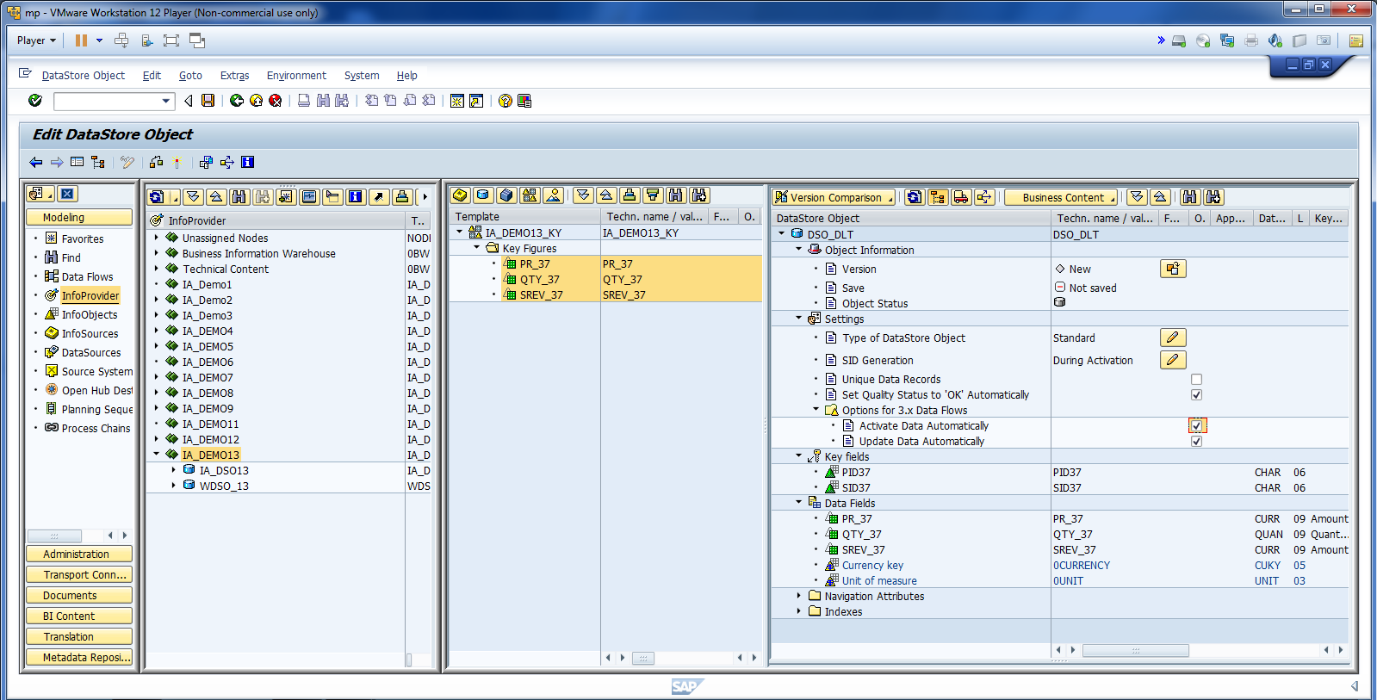
Click Update and Activate Data Automatically.

Slide 7
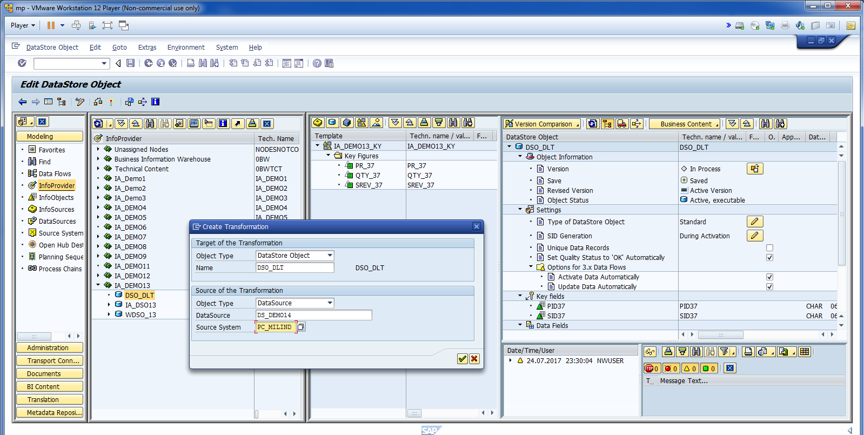
Create Transformation.

Slide 8
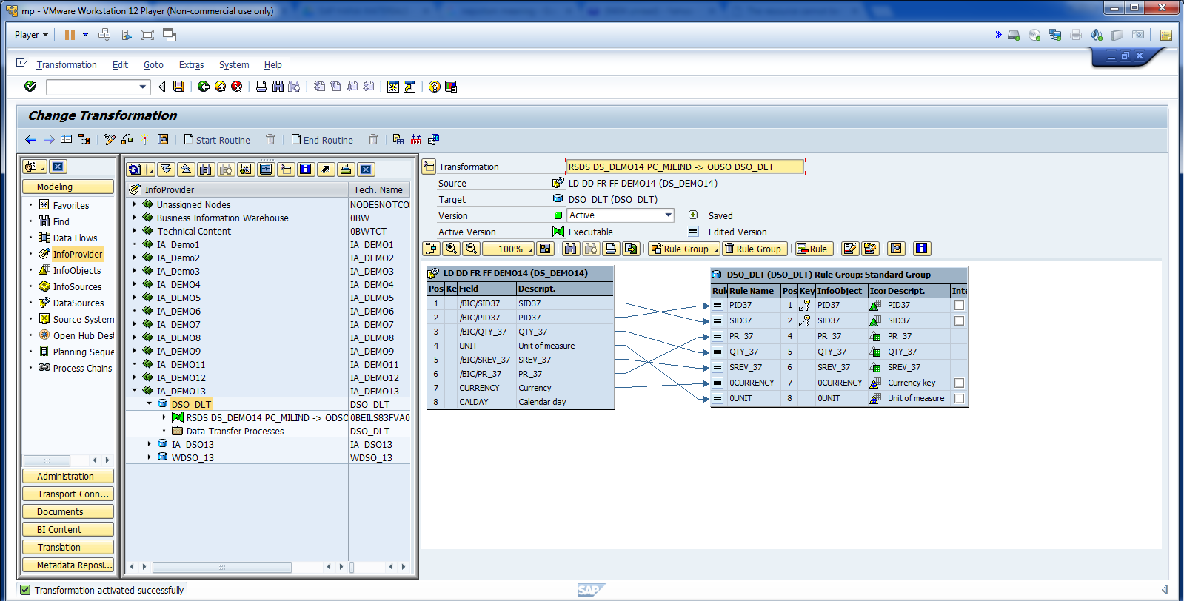
Cont.

Slide 9
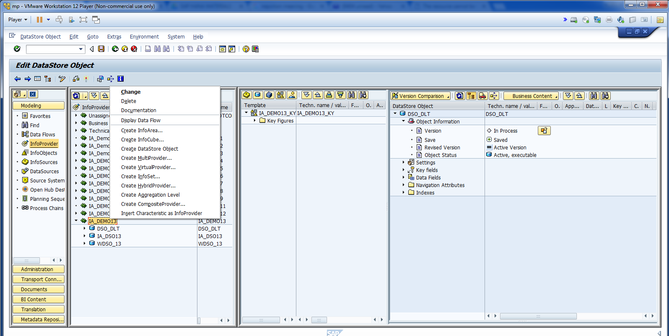
Create Info Area.

Slide 10
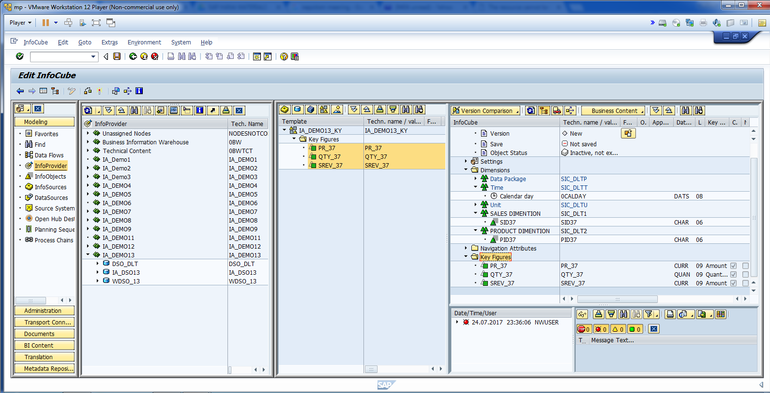
Update all fields.

Slide 11
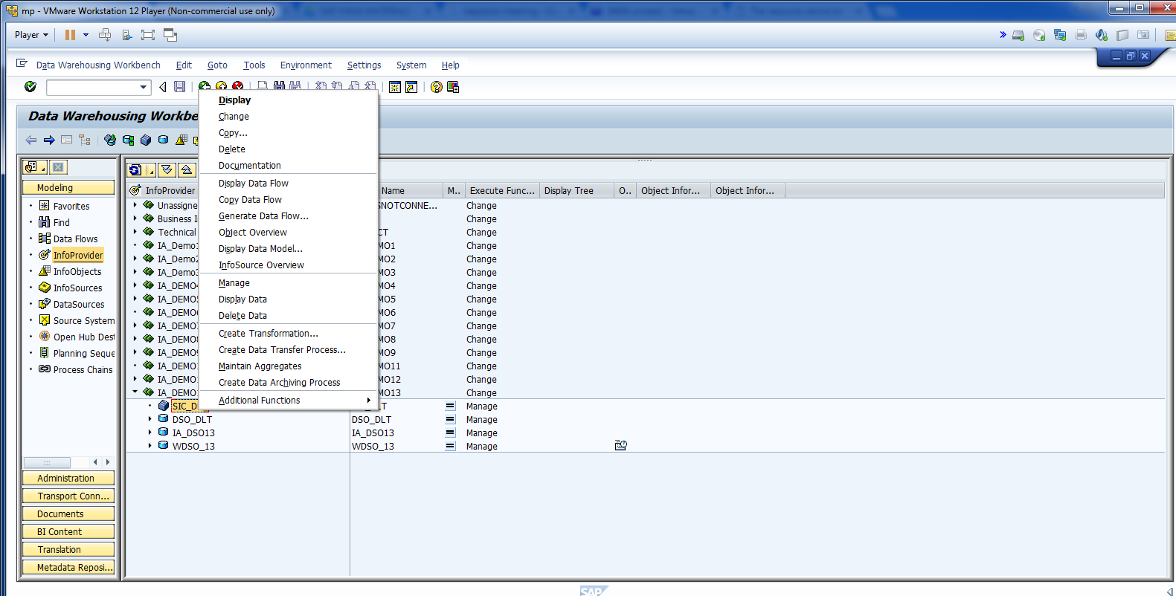
Create Transformation.

Slide 12
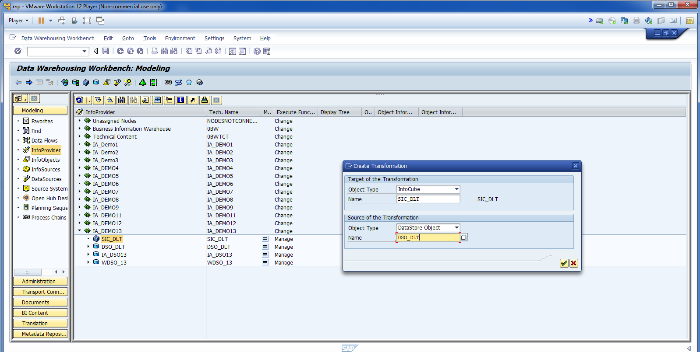
Create Transformation. Data transferring from DSO to InfoCube.

Slide 13
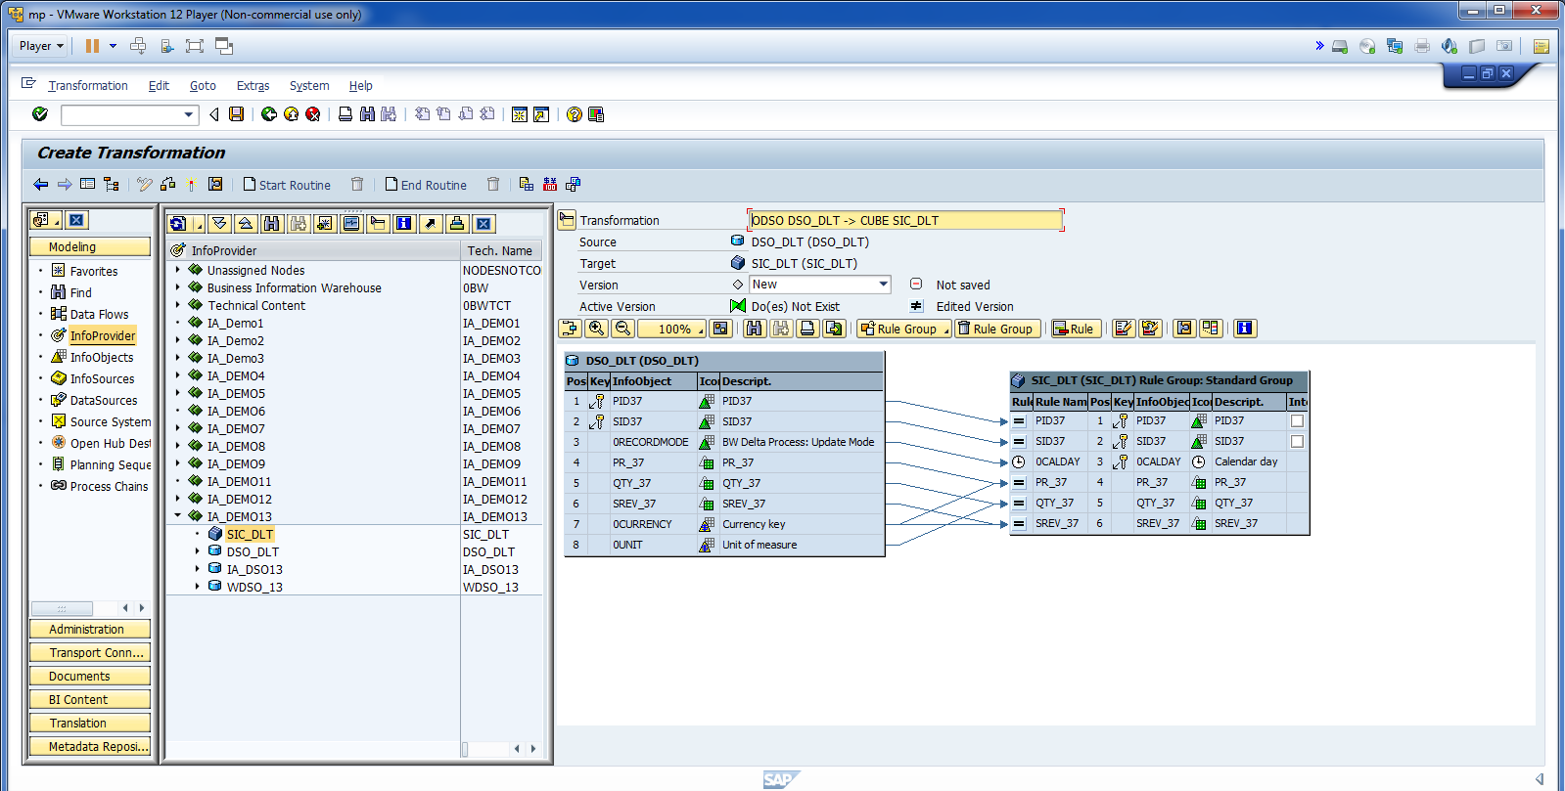
Cont.

Slide 14
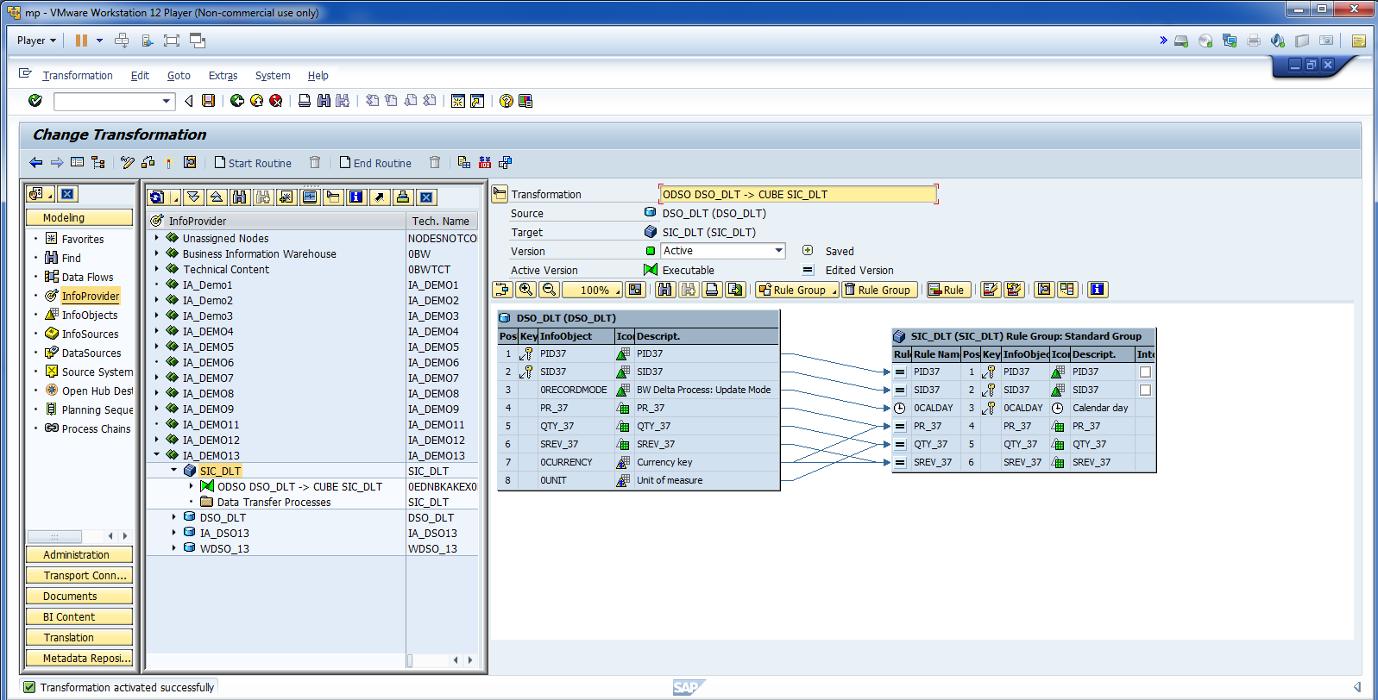
Activate.

Slide 15
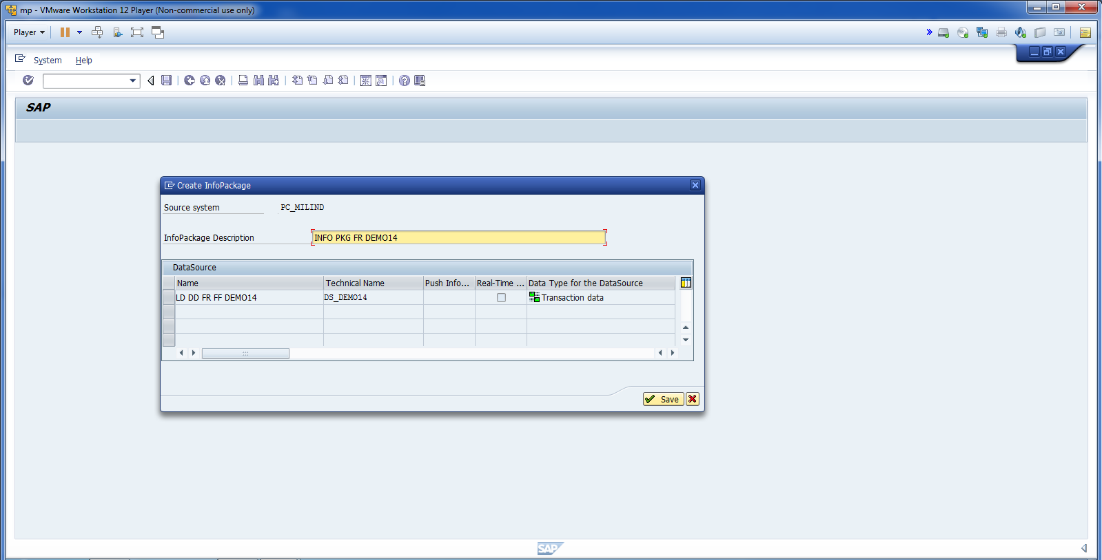
Create Info Package.

Slide 16
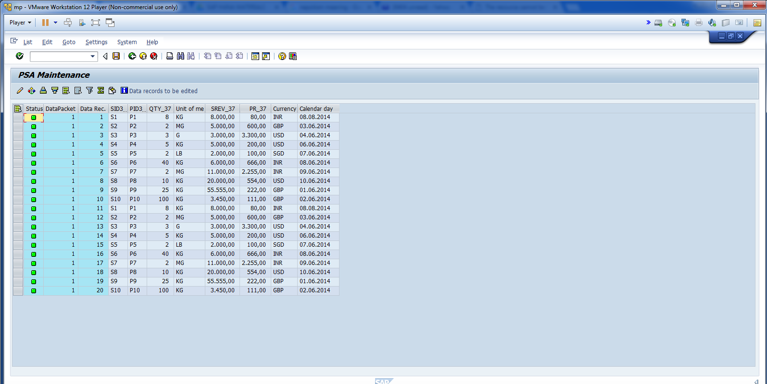
Data Loaded to PSA Successfully.

Slide 17
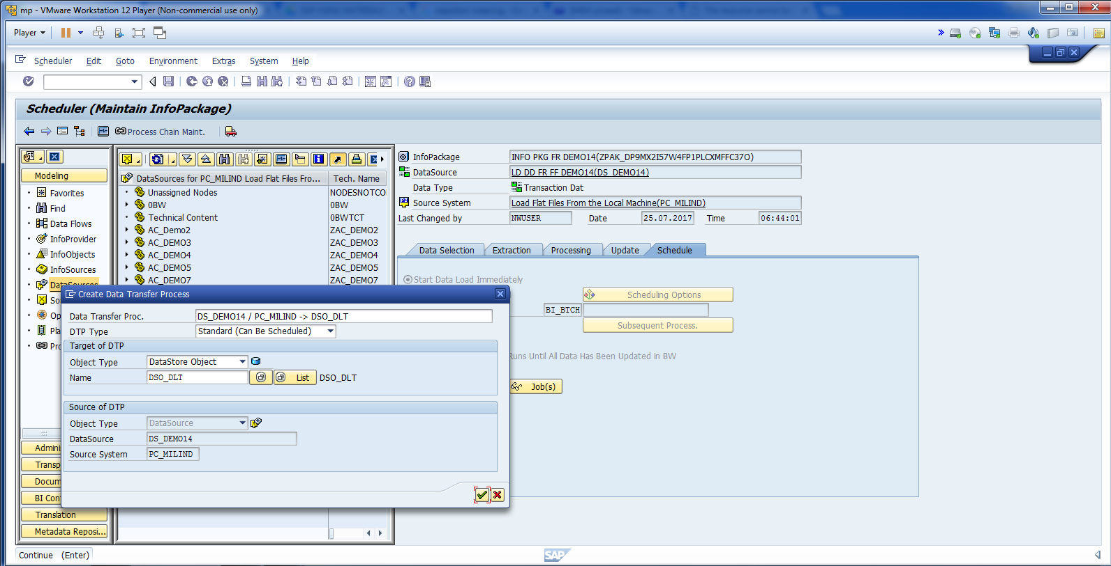
Now, loading data from PSA to DSO.

Slide 18
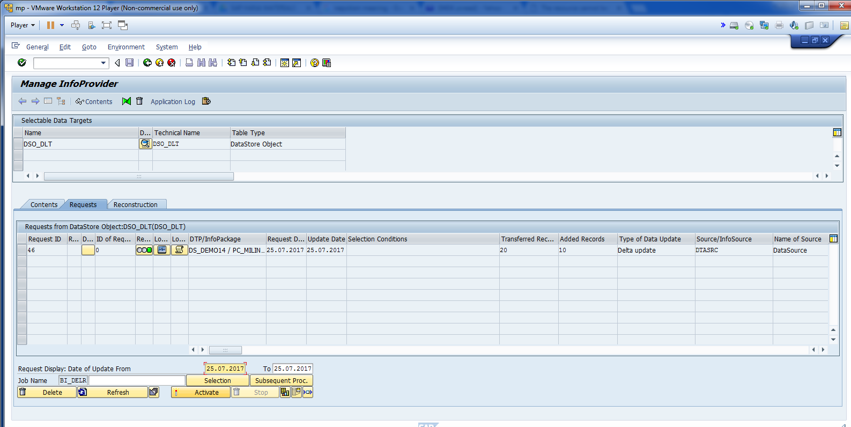
Activate DSO.

Slide 19
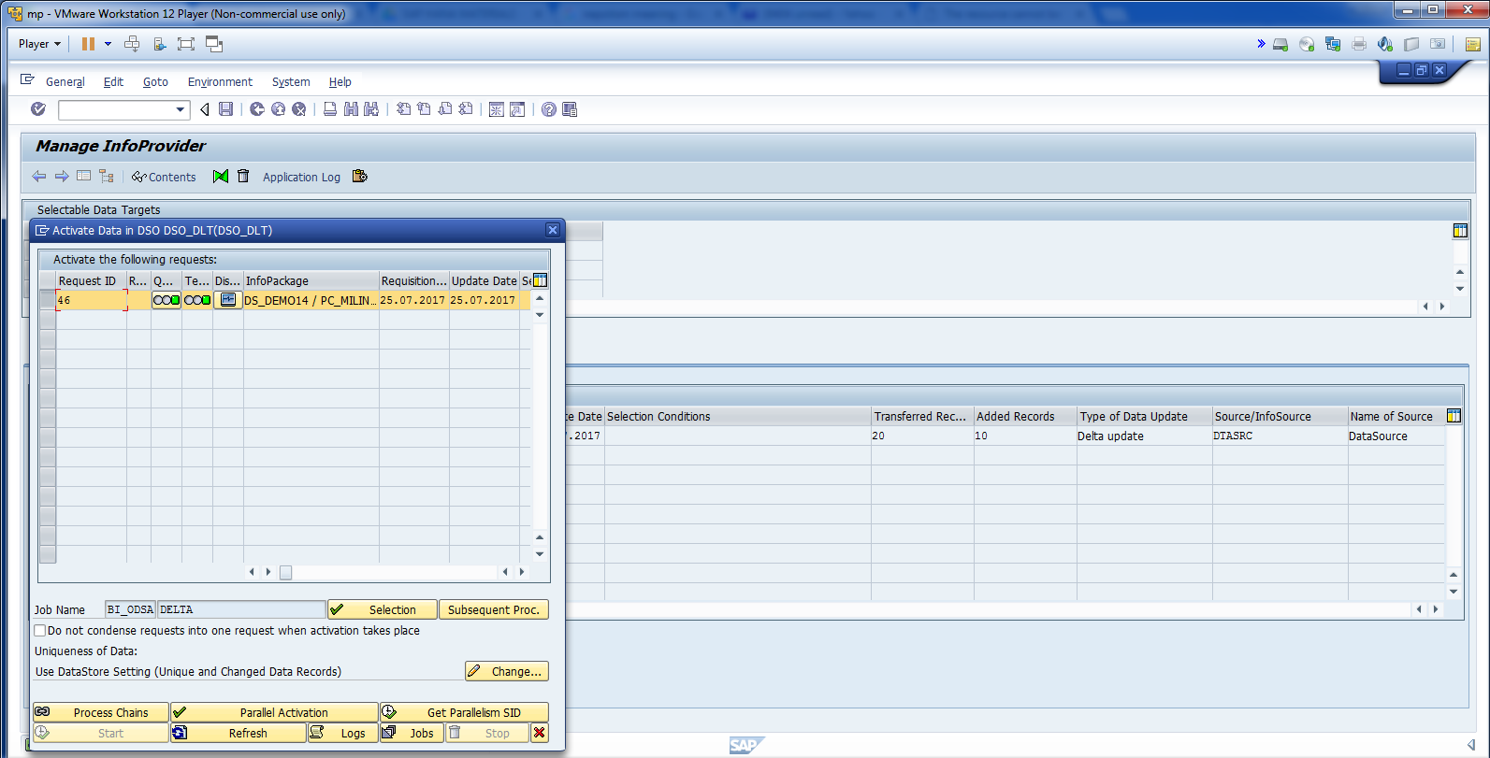
Cont.

Slide 20
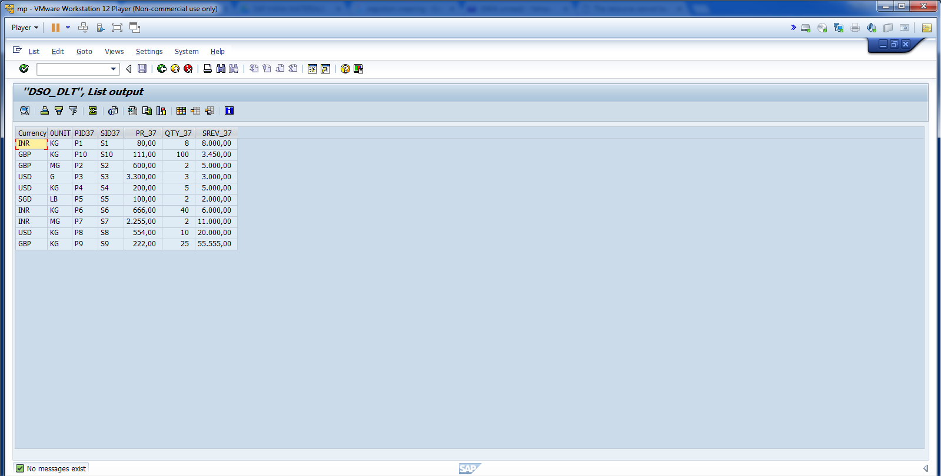
Cont.

Slide 21
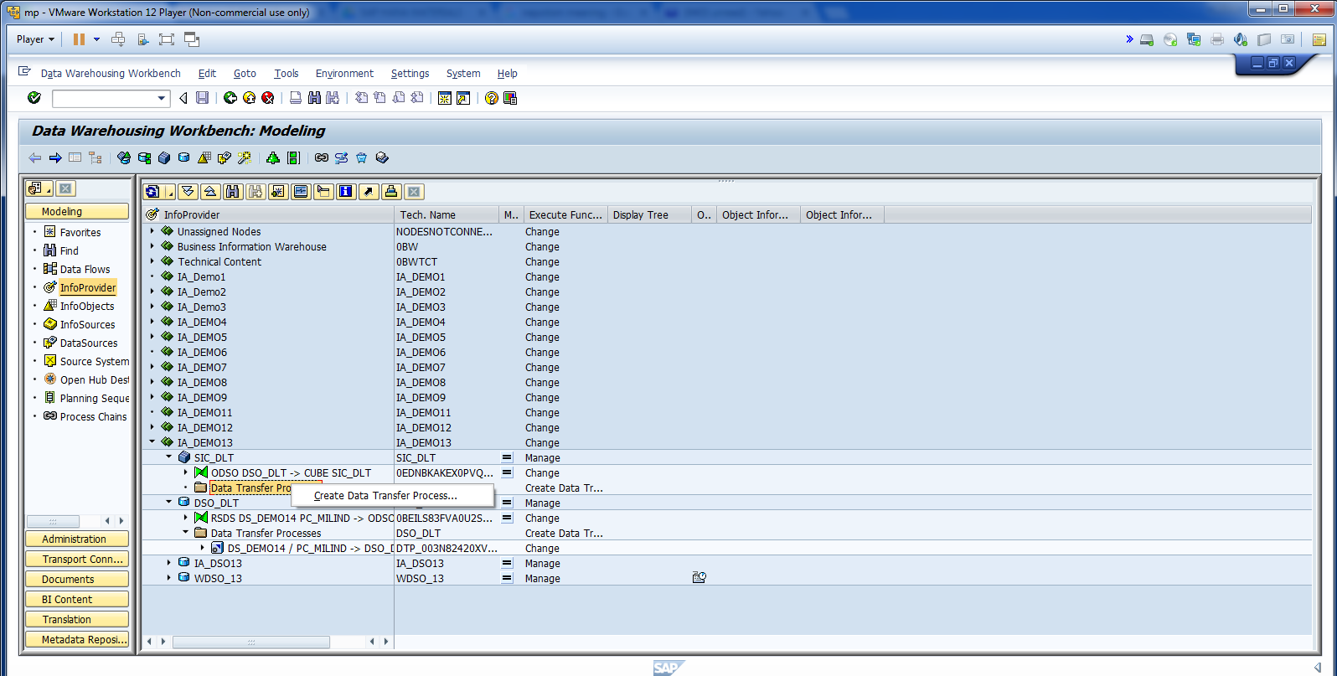
Create DTP to transfer data from DSO to InfoCube.

Slide 22
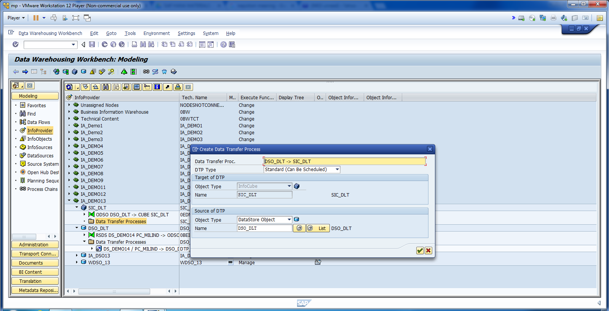
Cont.

Slide 23
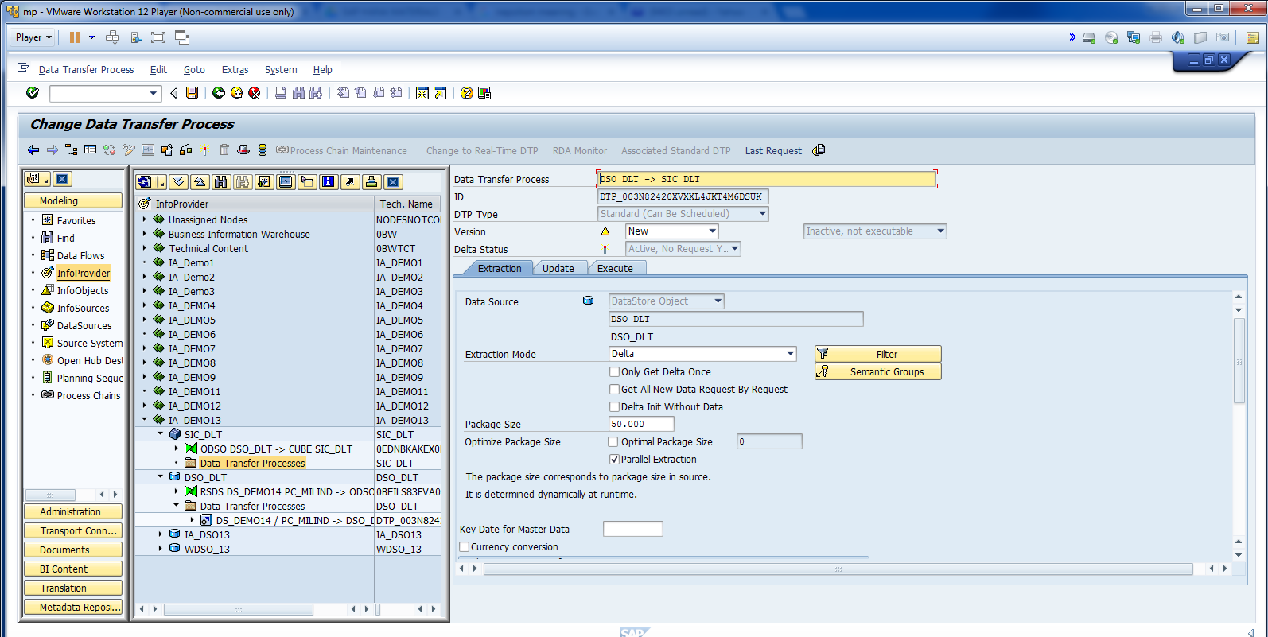
Extraction mode is delta.

Slide 24
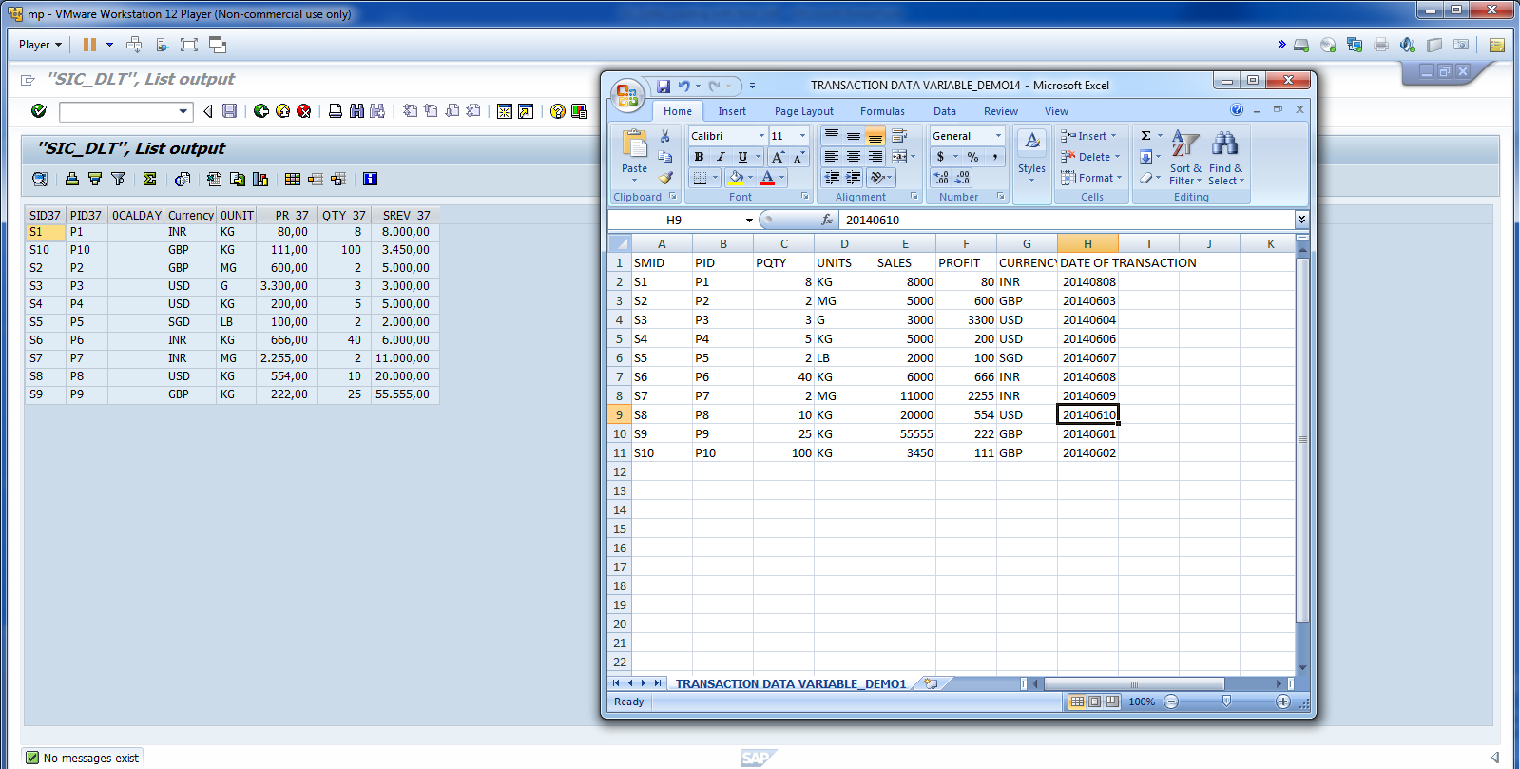
Cont.

Slide 25
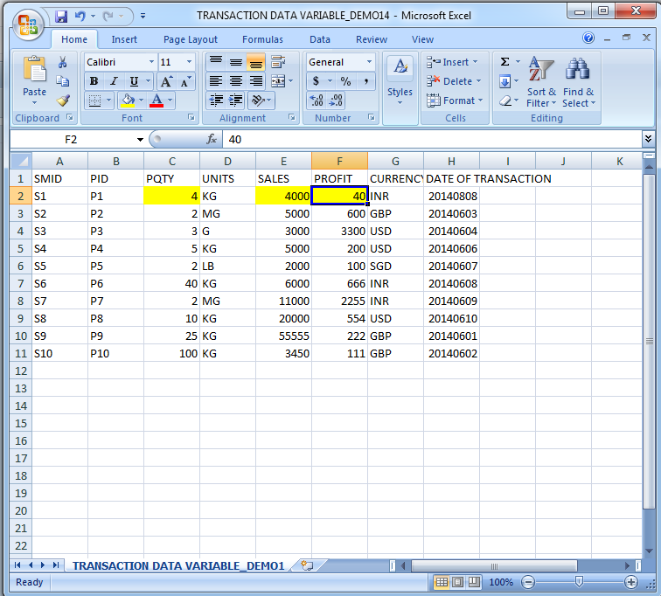
Change data in FF.

Slide 26
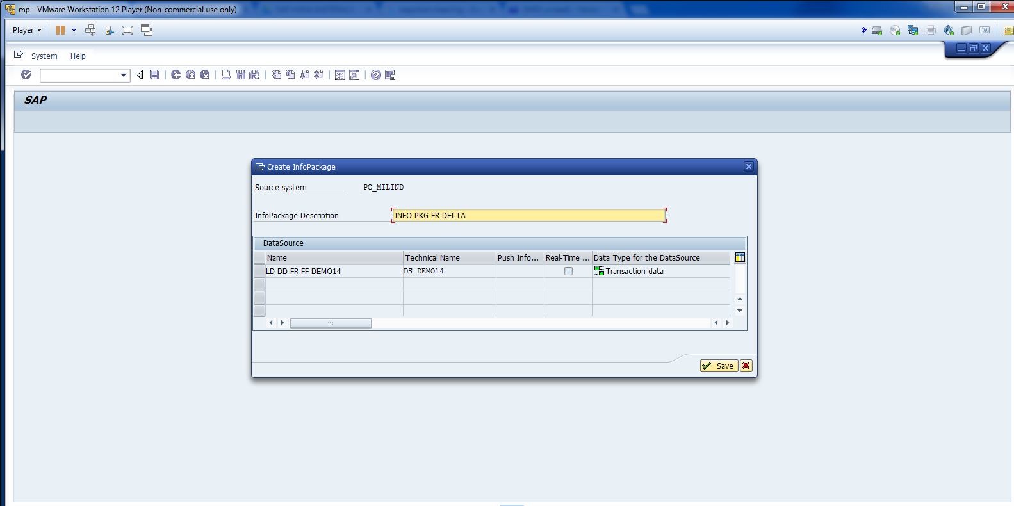
Cont.

Slide 27
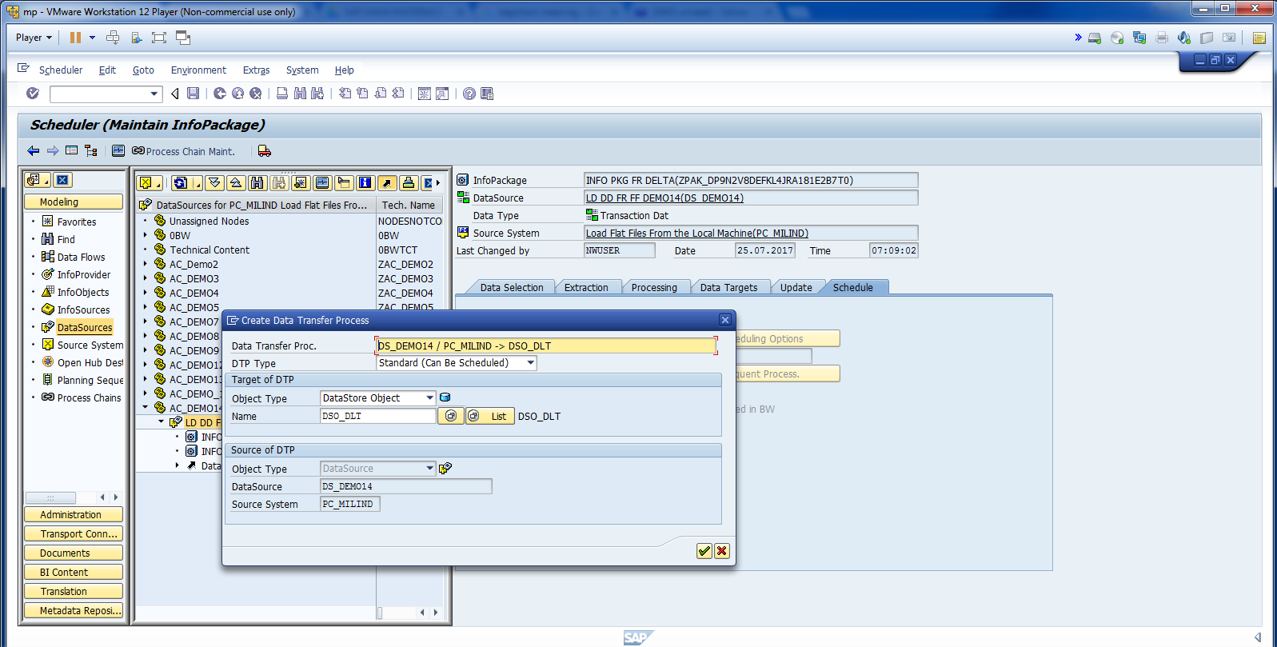
Create DTP.

Slide 28
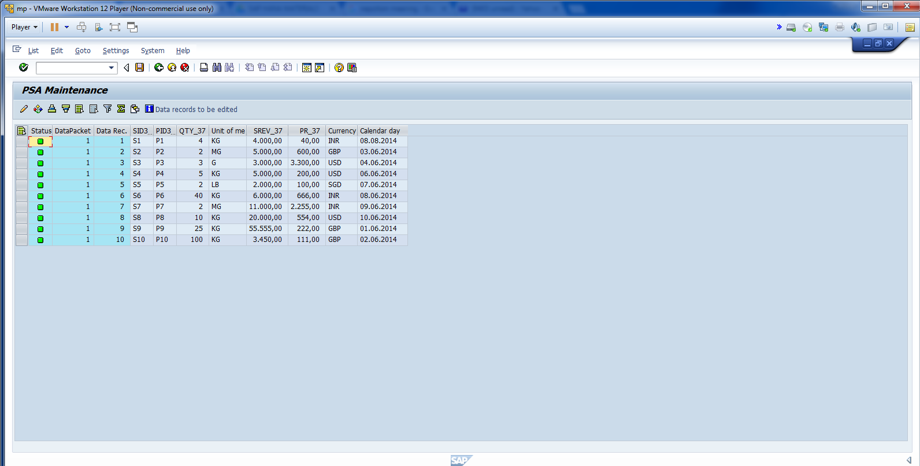
Data loaded in PSA.

Slide 29
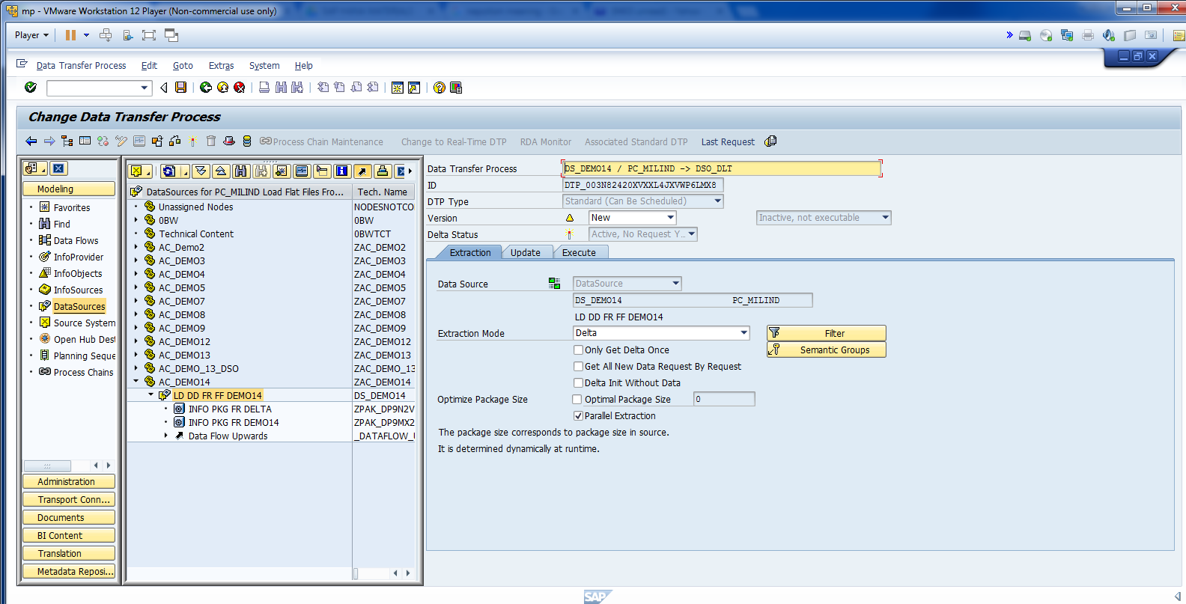
Extrication Mode Delta.

